Slide 1
Overview of (some) Epigenetics
STAT115

Slide 2
The Seqs
Bisulfite, ATAC, ChIP, MNase, DNase, FAIRE
chromHMM
Chromatin Conformation Capture
3C, 4C, 5C, Hi-C, ChIA-PET

Slide 3
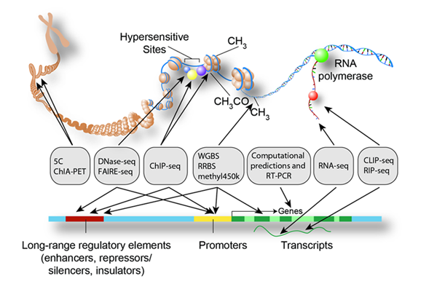

Slide 4
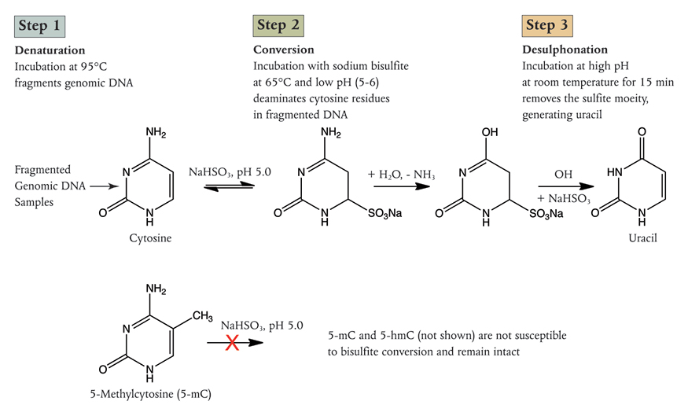

Slide 5
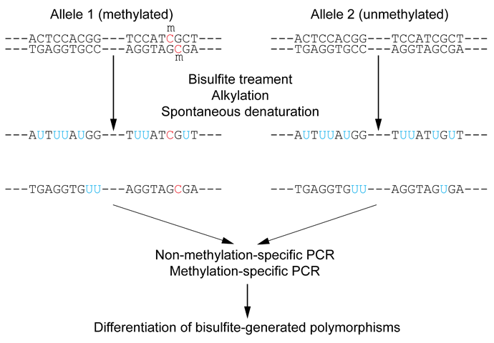

Slide 6
DNA Methylation
~28 Million CpGs
Sequence
Whole genome bisulfite
Reduced representation
Use a microarray (next slide)
Illumina 450K or EPIC

Slide 7
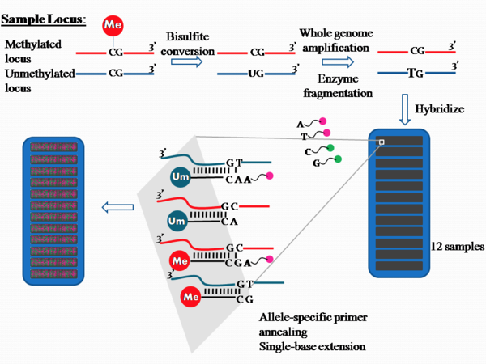
DNA Methylation

Slide 8
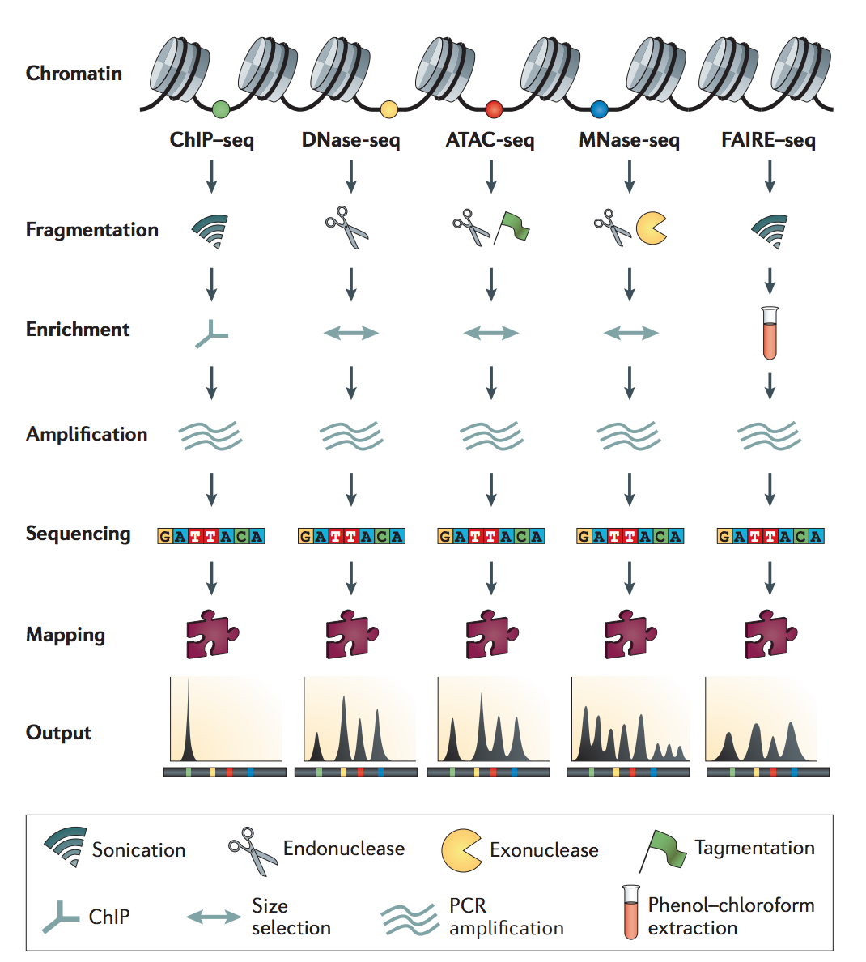
Meyer and Liu,
Nature Reviews Genetics 2014

Slide 9
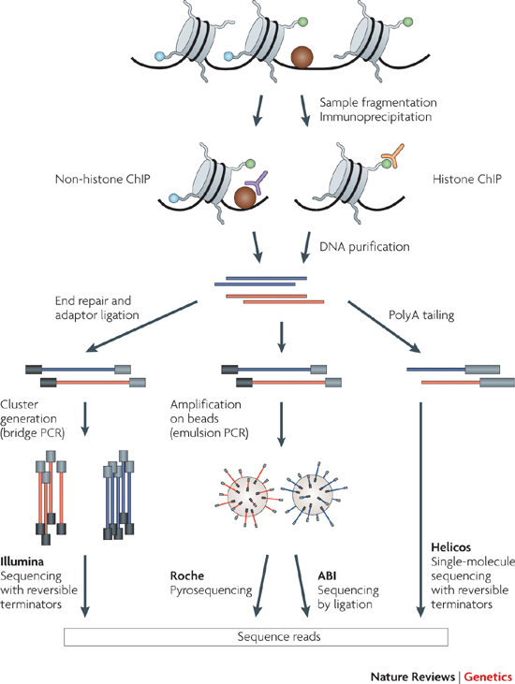
ChIP-Seq

Slide 10
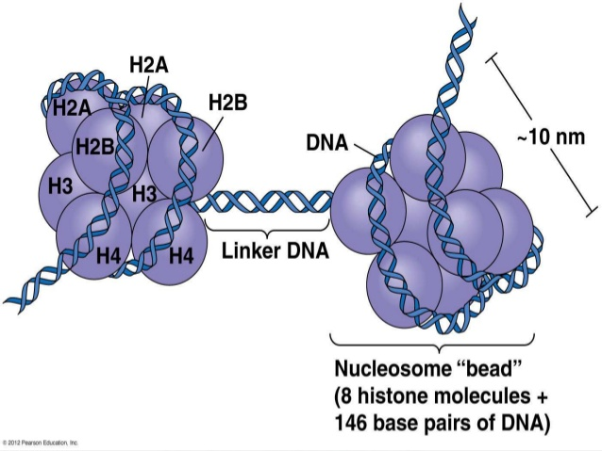
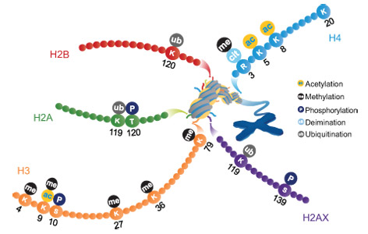
Histone Modifications

Slide 11
Meyer and Liu,
Nature Reviews Genetics 2014

Slide 12
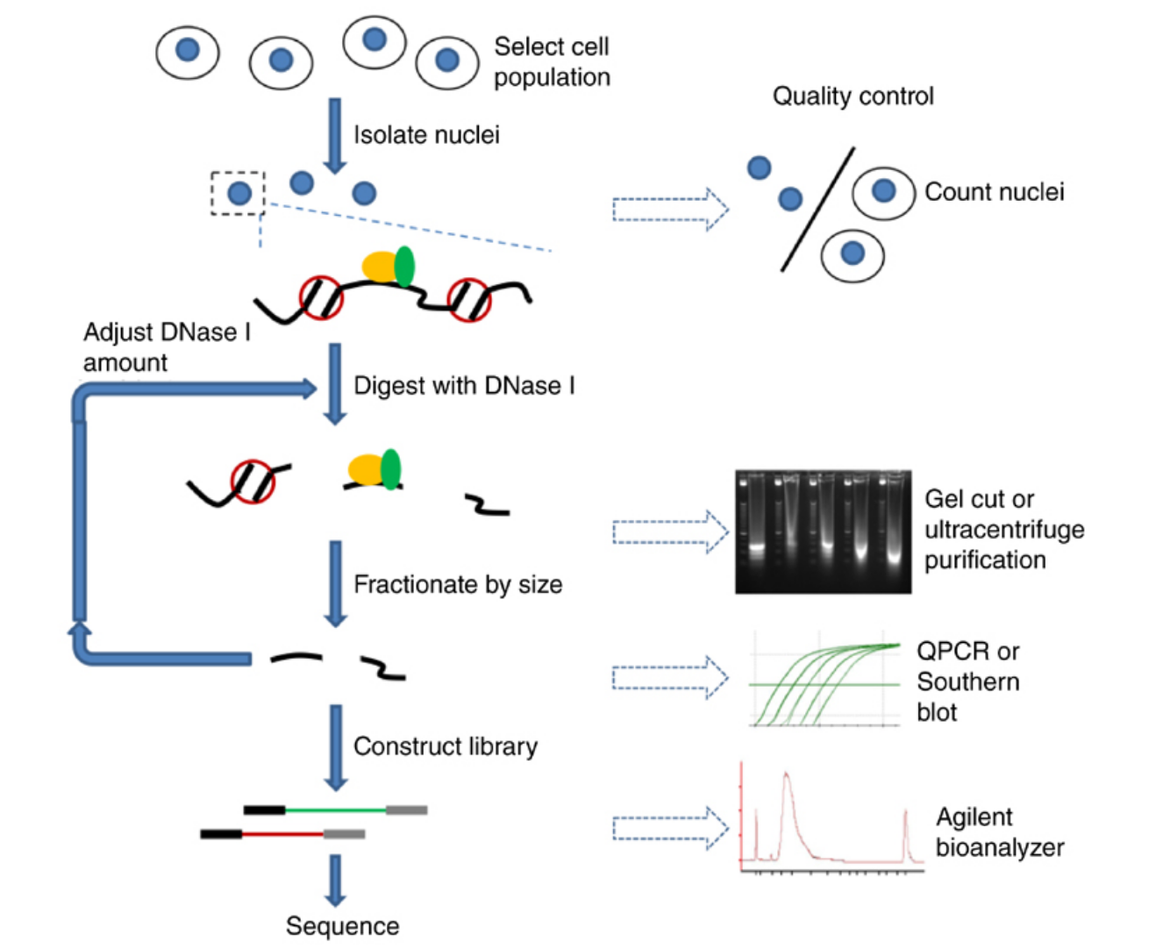
Dnase-Seq

Slide 13
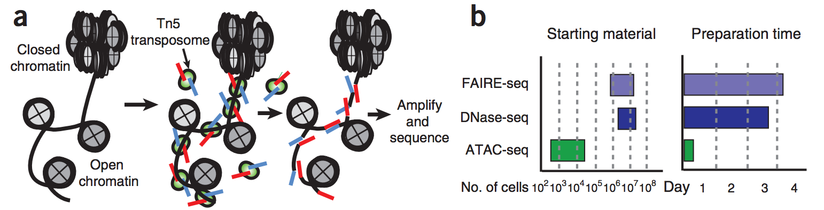
ATAC-Seq

Slide 14
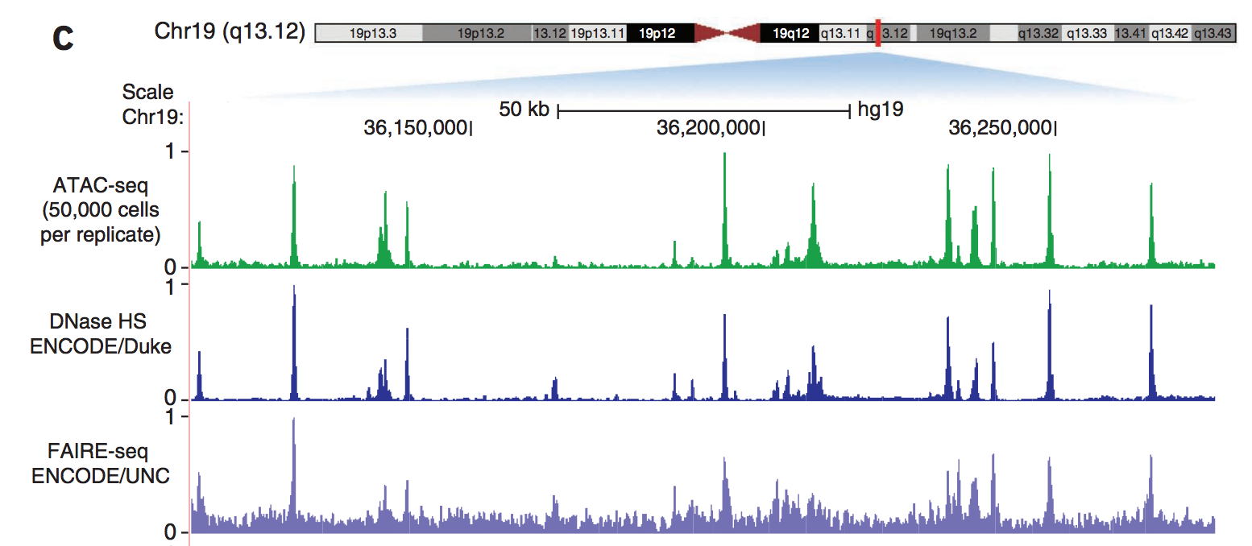

Slide 15
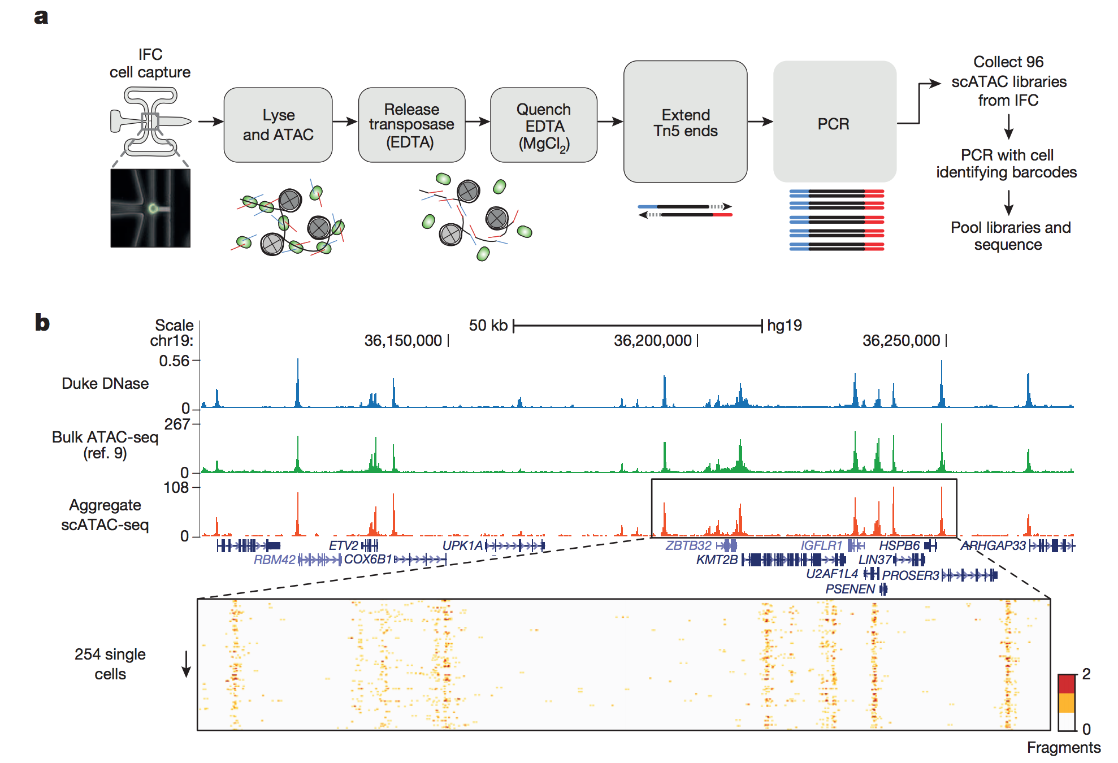

Slide 16
chromHMM

Slide 17
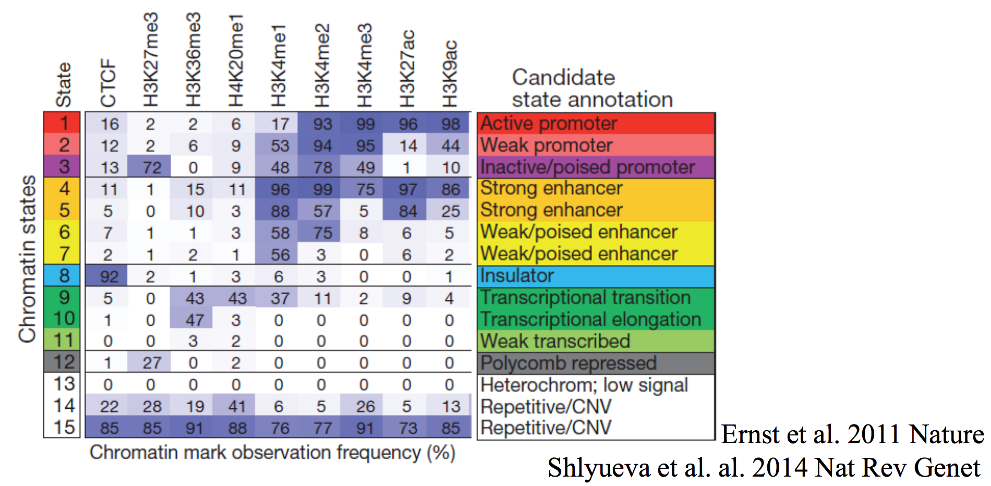

Slide 18
Chromosome Conformation Capture

Slide 19
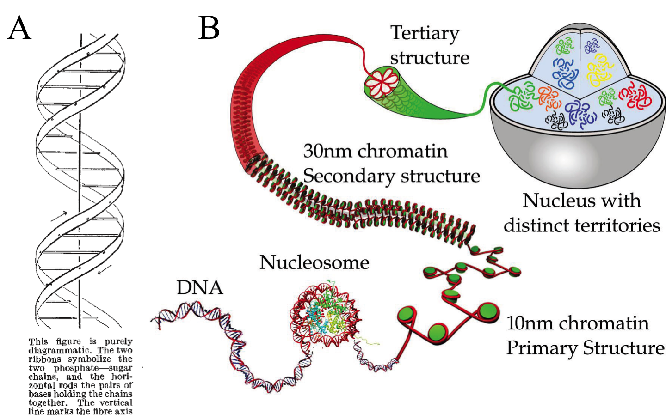

Slide 20
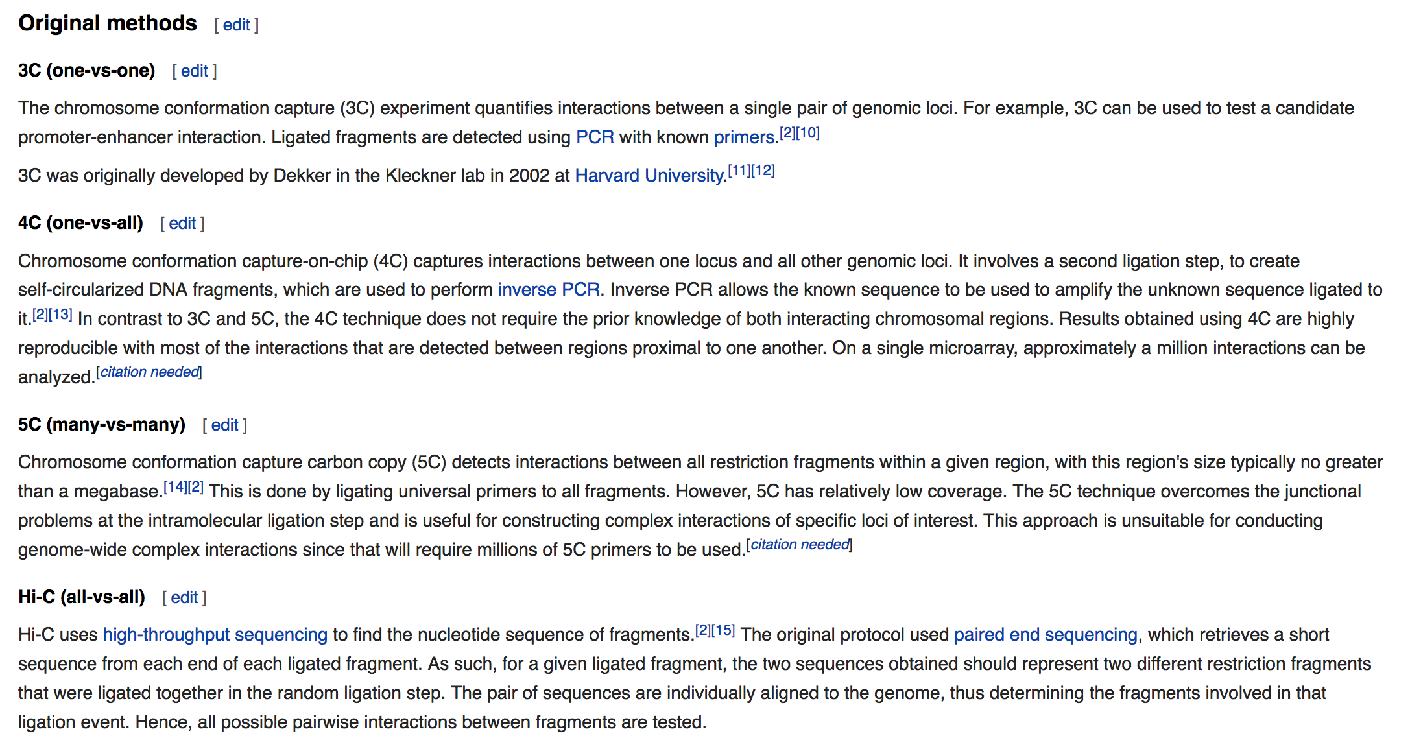

Slide 21
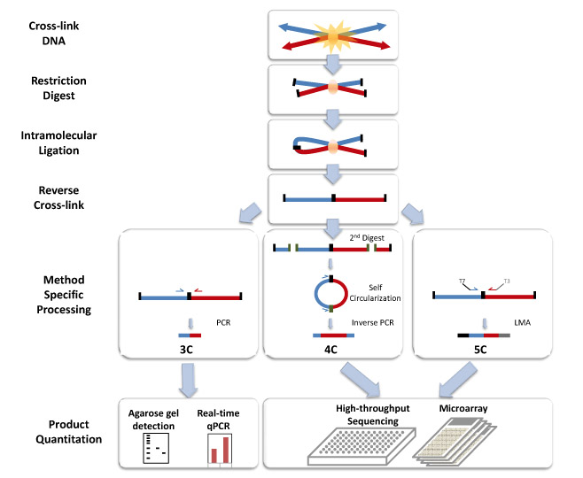

Slide 22
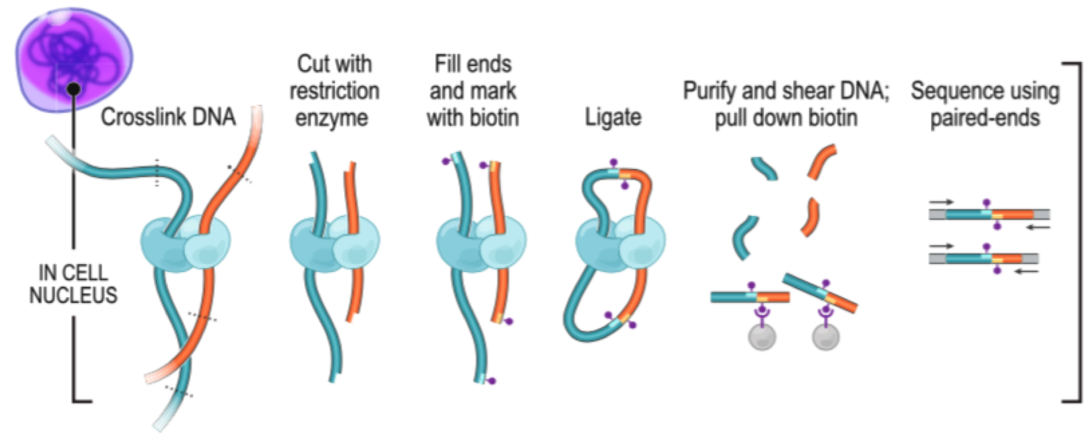
Hi-C

Slide 23
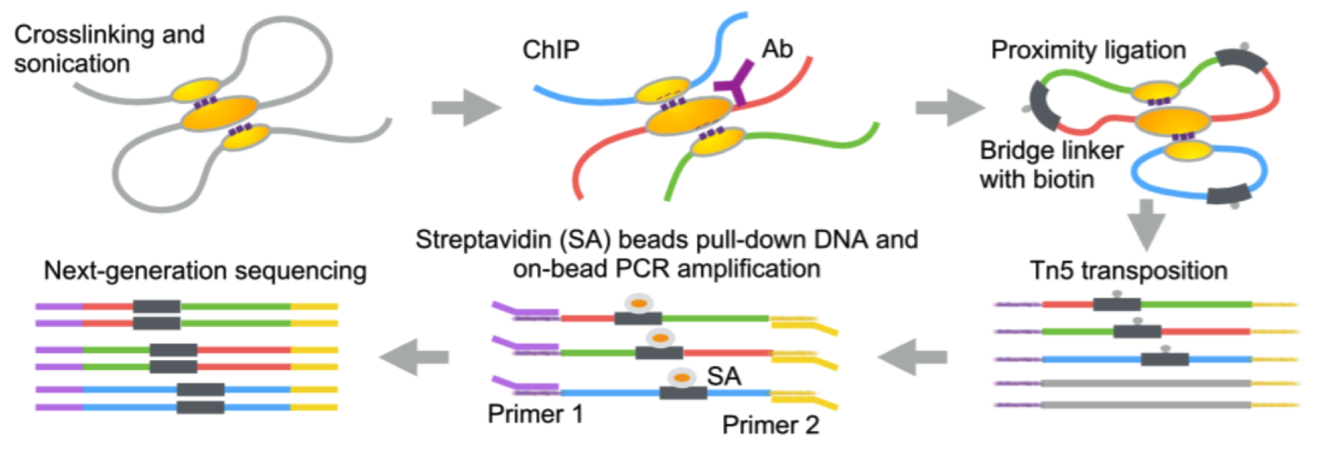
ChIA-PET

Slide 24
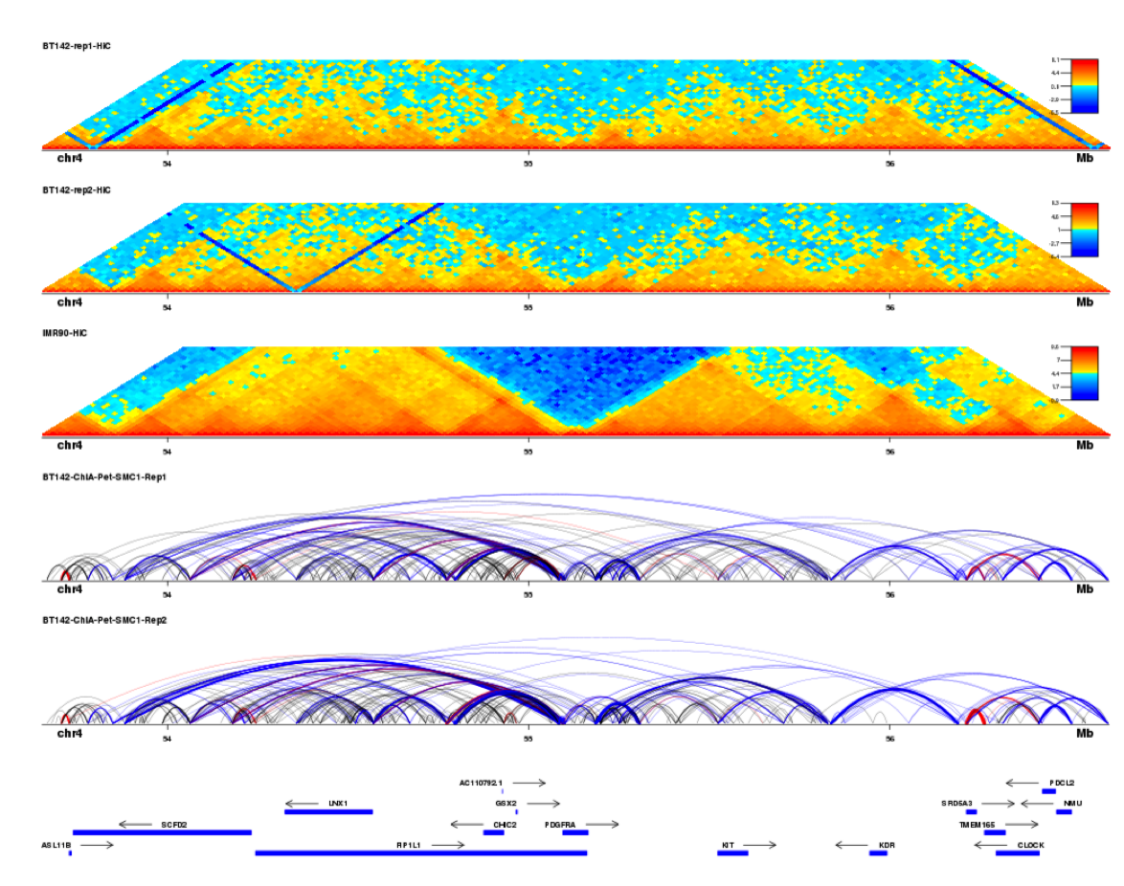
Hi-C
ChIA-PET

Slide 25
Integrative Epigenetics + Cancer

Slide 26
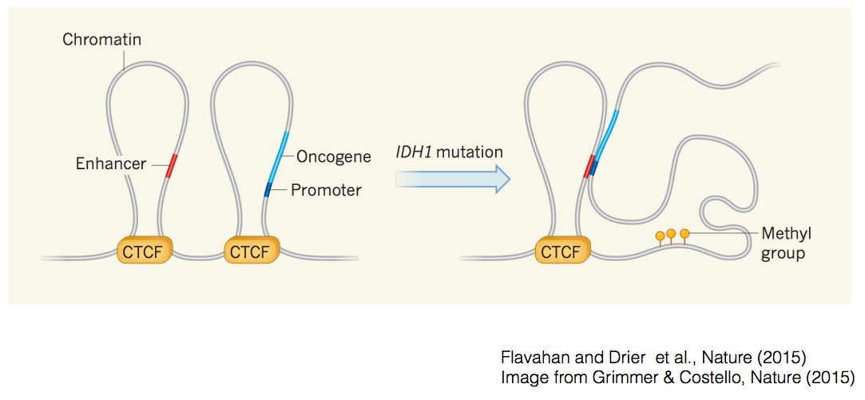

Slide 27
Thanks!

